Slide 1


Slide 2



KOLSCHES
HUUS.

Slide 3
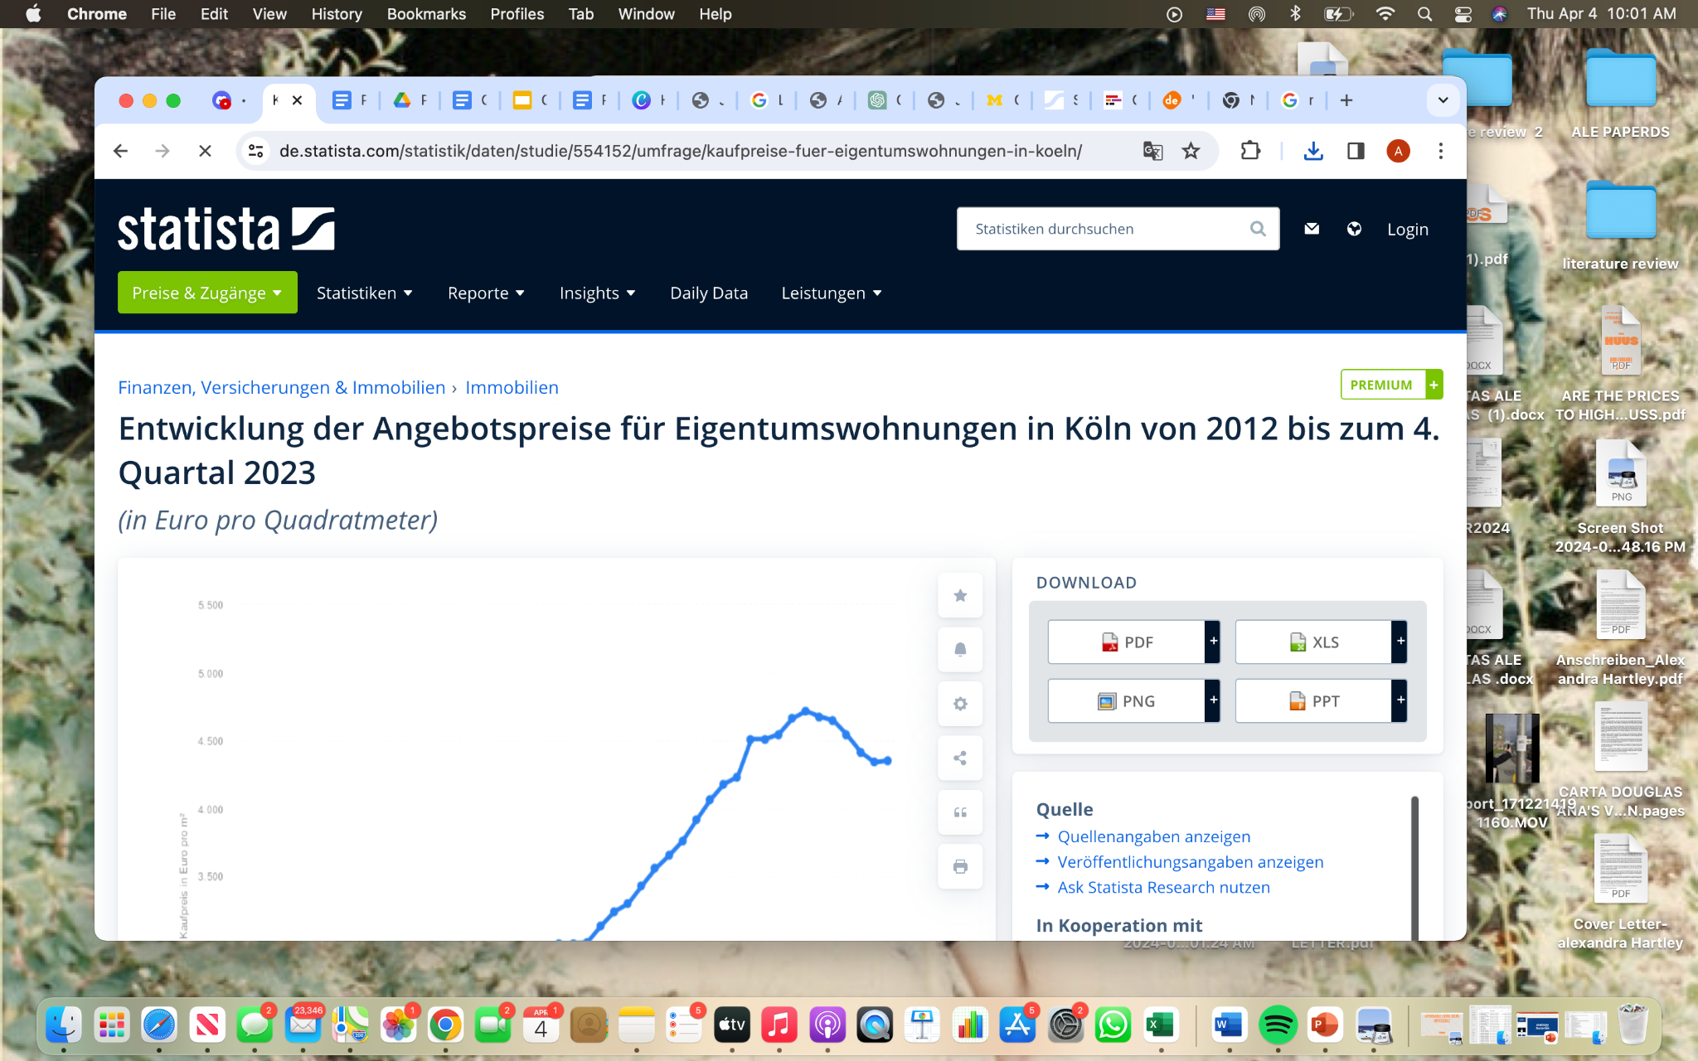
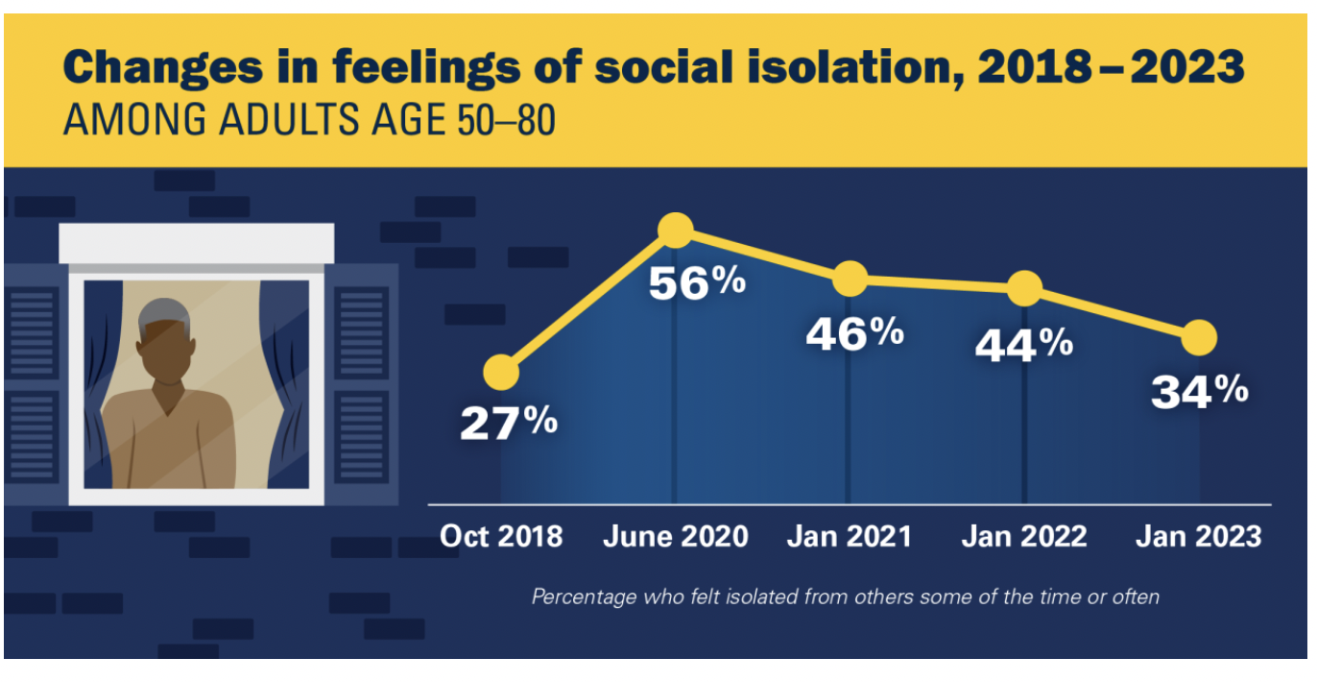
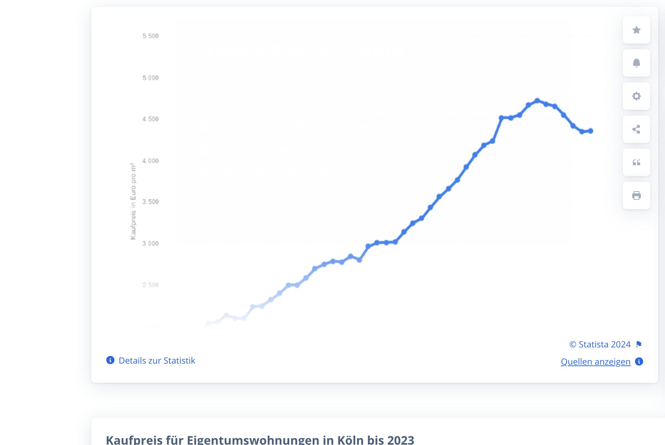

Slide 4


Slide 5






SEND IN YOUR
DETAILS
MATCH

Slide 6
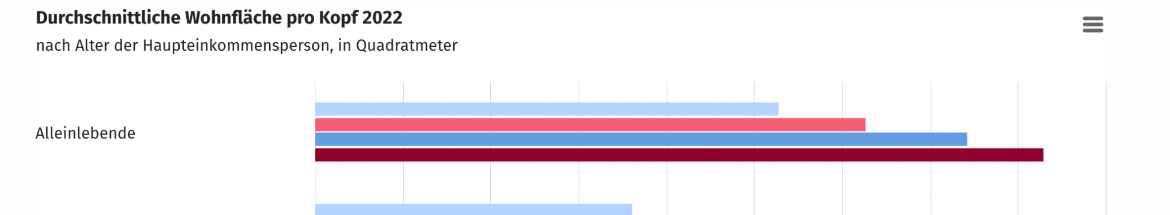
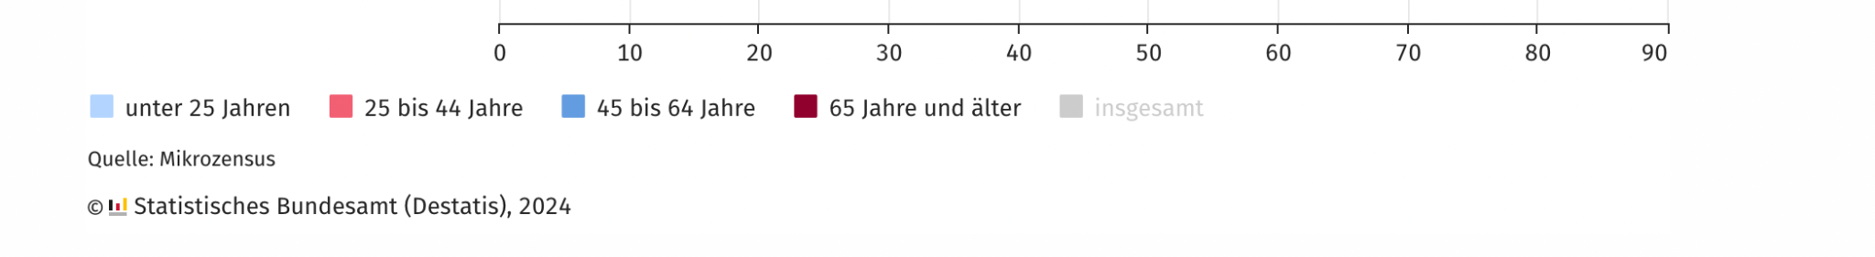
https://www.destatis.de/DE/Presse/Pressemitteilungen/2023/06/PD23_N035_12.html

Slide 7


Slide 8





OUR
FUNCTIONS.
ALL IN ONE.
ACCESSIBLE OPTION
AUTOMATIC
PAYMENT
SET UP
AVALIABILITY
SET UP AND ACCESS ALL YOUR RENTAL DOCUMENTS, QUERIES AND INFORMATION THROUGH OUR HELPLINE.
ALL DOCUMENTS
IN ONE PLACE.
QUERIES AND
COMPLAINTS
CALL HOTLINE

Slide 9









ZWECK
FRIENDLY
CARE+
WG
WG
WG
Avaliable to those with nursing and retirement care
qualification
UP TO 3-6 HOURS
REDUCED RENT
REDUCED RENT
SINGLE ROOM
LOWER COST*
FULL-TIME CARE
REDUCE LONLINESS IN
ELDERLY POPULATION
GOVERNMENT
SUBSIDIARY
BENEFICIAL FOR THE
COMMUNITY
NO HOURS
REQUIRED
*Compared to market price.

Slide 10


Slide 11

HUUS.
ZU HAUSE. ZUSAMMEN.
CHOOSE HUUS.

Slide 12
Annexes
https://ihpi.umich.edu/news/pandemics-third-anniversary-loneliness-and-isolation-are-down-still-high-among-older-adults
https://de.statista.com/statistik/daten/studie/554152/umfrage/kaufpreise-fuer-eigentumswohnungen-in-koeln/
https://www.destatis.de/DE/Presse/Pressemitteilungen/2023/06/PD23_N035_12.html

Slide 13


